Slide 1

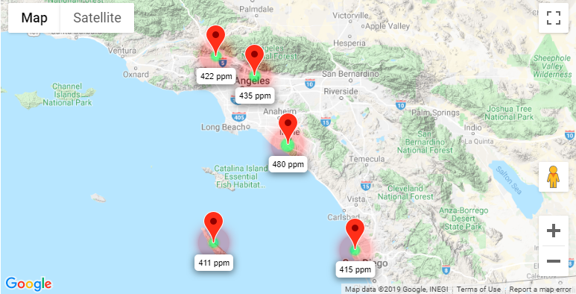
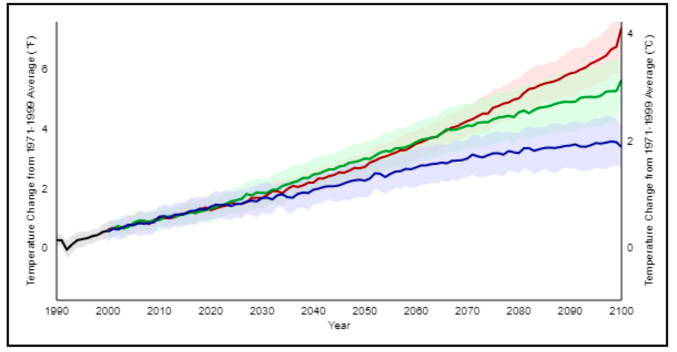



Greenhouse LA
A visual presentation of CO₂ and CH₄ emissions in the LA basin, powered by data from NASA’s Megacities project
Interactive data plots
In 2013, CO₂ levels in the atmosphere passed 400ppm for the 1st time in millions of years. If current rates of CO₂ emissions continue, the Earth will be 2°C warmer by 2050, with severe consequences for our climate
Help stop global warming
Organisations are working to cut greenhouse gas emissions in California by encouraging more sustainable practices. Here’s how you can help:
Environment California
Citizen’s Climate Lobby
Statewide, citizen-based environmental advocacy organization. Focused on electric vehicles, renewable energy, and wildlife
Be empowered to work on climate change solutions with 400 local chapters the US. Build support in Congress for a national bipartisan solution to climate change.
Info
Join
Info
Join

